Slide 1
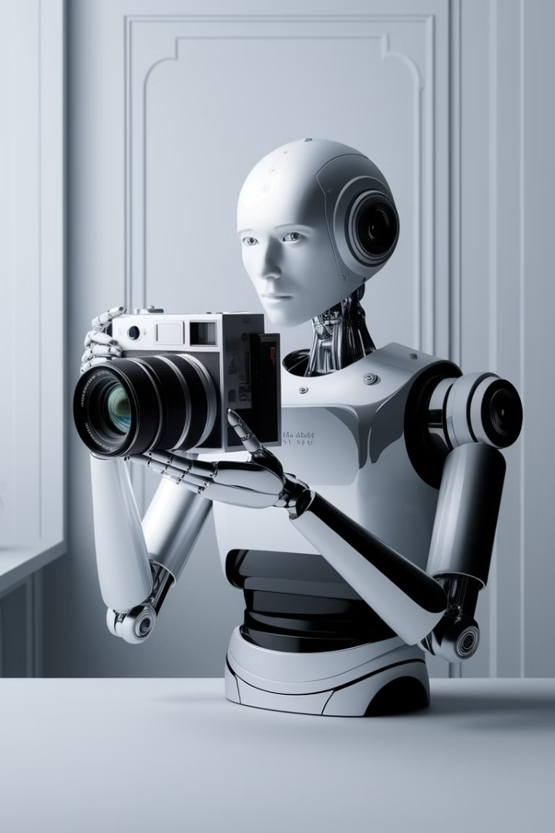
Introduction to Transformers in Computer Vision
Transformers, initially used in natural language processing, have become increasingly popular in computer vision. Their ability to capture long-range dependencies and process sequential data has enabled advancements in various tasks like image classification and object detection.
DN

Slide 2





From Convolutional Neural Networks to Transformers
Convolutional Neural Networks (CNNs)
CNNs excel at recognizing local patterns and features. They leverage convolution operations to extract spatial information from images.
Limitations of CNNs
CNNs struggle to capture long-range dependencies and global context within images. They are not as effective at modeling complex relationships between distant pixels.
Transformers Emerge
Transformers, originally developed for natural language processing, offer a powerful alternative for computer vision tasks.
Global Context and Relationships
Transformers excel at capturing long-range dependencies and global context, making them well-suited for complex image analysis tasks.

Slide 3
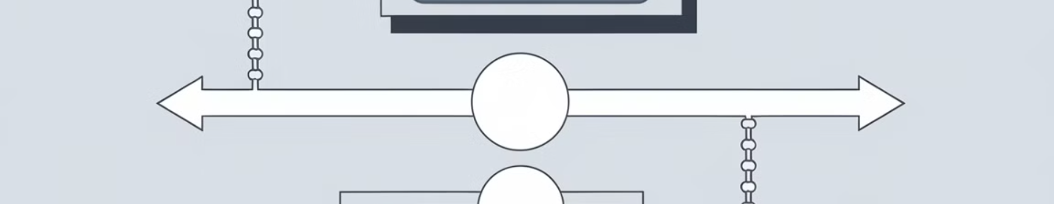


Encoder-Decoder Architecture
Encoder
Decoder
It processes the input image and extracts features.
It uses the encoded features to generate the desired output, which might be a classification, segmentation, or other task-specific output.

Slide 4
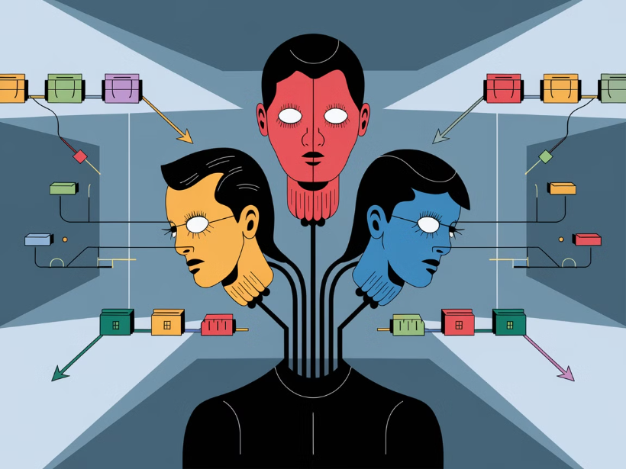
Self-Attention: The Core of Transformers
Self-attention is a mechanism that allows a transformer to attend to different parts of an input sequence. It helps the model understand the relationships between words in a sentence or pixels in an image.
The self-attention mechanism calculates attention weights for each element in the input sequence, indicating how much attention should be paid to each element. These weights are then used to compute a weighted sum of the input elements.

Slide 5
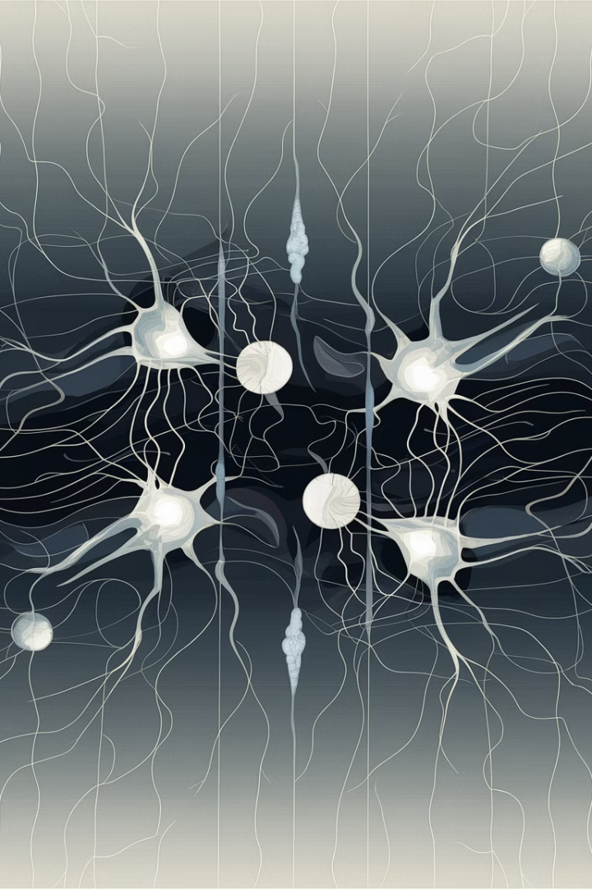
Advantages of Self-Attention
Global Context
Parallel Processing
Self-attention enables transformers to consider relationships between all elements in an image, capturing long-range dependencies.
The self-attention mechanism is highly parallelizable, making it suitable for efficient computation on modern hardware.
Adaptability
Self-attention is flexible and can be adapted to various computer vision tasks, including image classification, object detection, and segmentation.

Slide 6
Applications of Self-Attention in Computer Vision
Image Classification
Object Detection
Image Segmentation
Image Generation
Self-attention allows models to identify relationships between different parts of an image, leading to improved classification accuracy.
Self-attention helps models pinpoint objects within an image, enhancing the detection of multiple objects and their spatial relationships.
Self-attention enables precise segmentation of objects or regions in images by capturing long-range dependencies and contextual information.
Self-attention plays a key role in generating realistic and coherent images, capturing complex relationships between different image elements.

Slide 7
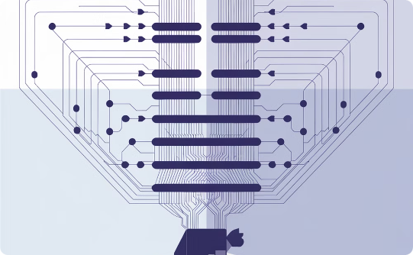


Transformers for Image Classification
Image Classification with Transformers
Training on Large Datasets
Performance and Accuracy
Transformers are trained on massive datasets of labeled images, enabling them to learn robust representations and generalize well to unseen images.
Transformers have achieved state-of-the-art performance in image classification tasks, surpassing traditional convolutional neural networks (CNNs).
Transformers can process images holistically, capturing long-range dependencies and relationships between different regions.

Slide 8
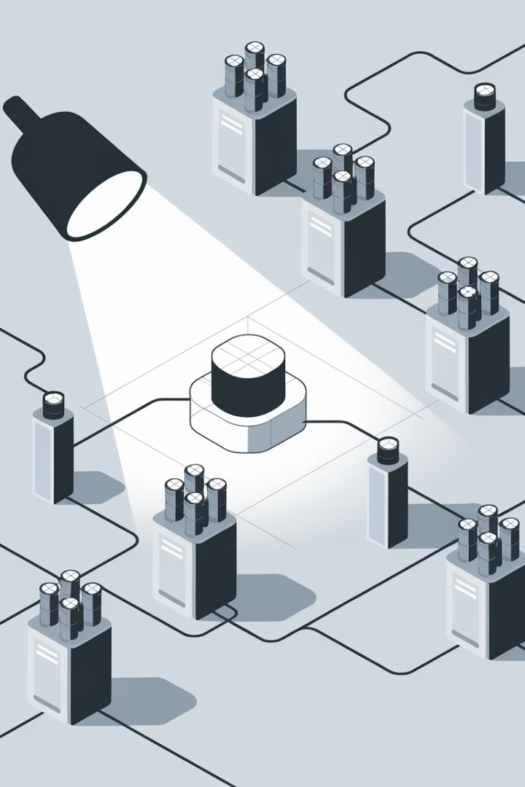
Transformers for Object Detection
1
1. Bounding Box Prediction
2
2. Improved Accuracy
Self-attention mechanisms enable transformers to capture long-range dependencies, improving object detection accuracy.
Transformers can predict precise bounding boxes for objects, even in complex scenes.
3
3. Enhanced Feature Learning
Transformers learn richer and more discriminative features compared to traditional CNNs.

Slide 9
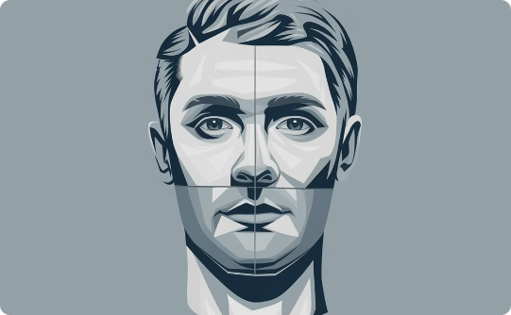

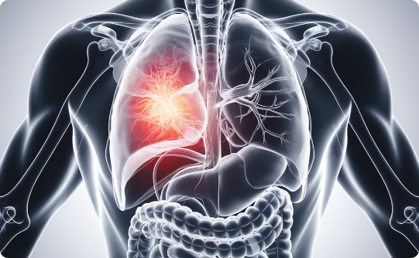
Transformers for Image Segmentation
Precise Object Boundaries
Semantic Understanding
Medical Imaging Applications
Transformers excel at identifying intricate object boundaries, providing pixel-level precision in image segmentation.
They can distinguish and segment different objects based on their semantic meaning, enabling complex scene analysis.
Transformers are revolutionizing medical imaging, enabling accurate segmentation of tumors, organs, and other structures.

Slide 10

Transformers for Image Generation
1
Generative Models
2
Text-to-Image Synthesis
Transformers are now used to create realistic and high-quality images.
Transformers can generate images based on textual descriptions.
3
Image-to-Image Translation
4
Style Transfer
Transformers can transfer the style of one image to another.
Transformers can translate an image from one domain to another.

Slide 11
Transformer Encoder for Vision Tasks
Feature Extraction
1
The encoder captures essential features from the input image.
Contextual Relationships
2
It learns the spatial relationships between features.
Representation Learning
3
The encoded features represent the image in a meaningful way.
Output
4
Provides a compressed representation of the image.
The transformer encoder plays a crucial role in computer vision by processing and transforming the input image. This process involves extracting important features, understanding their relationships, and generating a compact representation. The output serves as a valuable input for downstream tasks.

Slide 12




Transformer Decoder for Vision Tasks
Output Generation
1
Generates the final output, such as an image or a caption.
Contextualization
2
Incorporates information from the encoder and the previously generated tokens.
Decoding Process
3
Transforms the encoded features into a sequence of tokens.
Self-Attention
4
Allows the decoder to focus on relevant parts of the encoded features.
Transformer decoders are essential for generating outputs, such as images or captions, based on the encoded information. They leverage self-attention mechanisms to learn dependencies between tokens and generate a coherent output.

Slide 13
Positional Encoding in Transformers
Transformer Limitations
Positional Encoding
Transformers lack inherent positional information, which can be crucial in tasks where order matters.
Encodes positional information into the input data, providing the model with contextual clues.
Without this information, they struggle to understand the sequential relationships within input data.
Allows transformers to understand the order and relationships of elements in the input sequence.

Slide 14





Masking in Transformers
Attention Masks
Causal Masking
Padding Masks
Sequence Masking
Masking techniques help control the self-attention mechanism.
Prevents the model from attending to future tokens.
Ignore padding tokens to avoid unintended attention.
Controls the flow of information within a sequence.

Slide 15
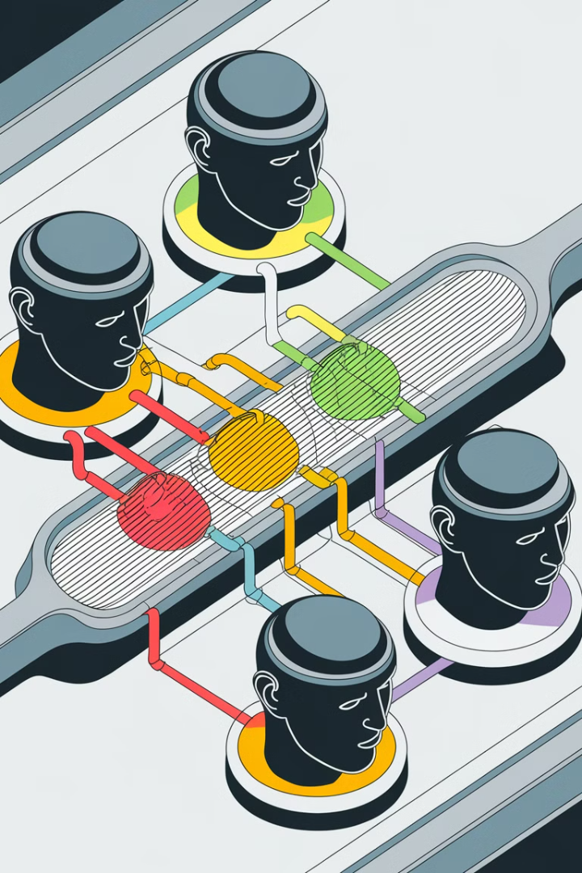
Multi-Head Attention in Transformers
Multiple Perspectives
Rich Context
Each head attends to different aspects of the input sequence.
Combining information from multiple heads creates a more comprehensive understanding of the data.
Improved Performance
Multi-head attention enhances the model's ability to capture complex relationships and patterns.

Slide 16
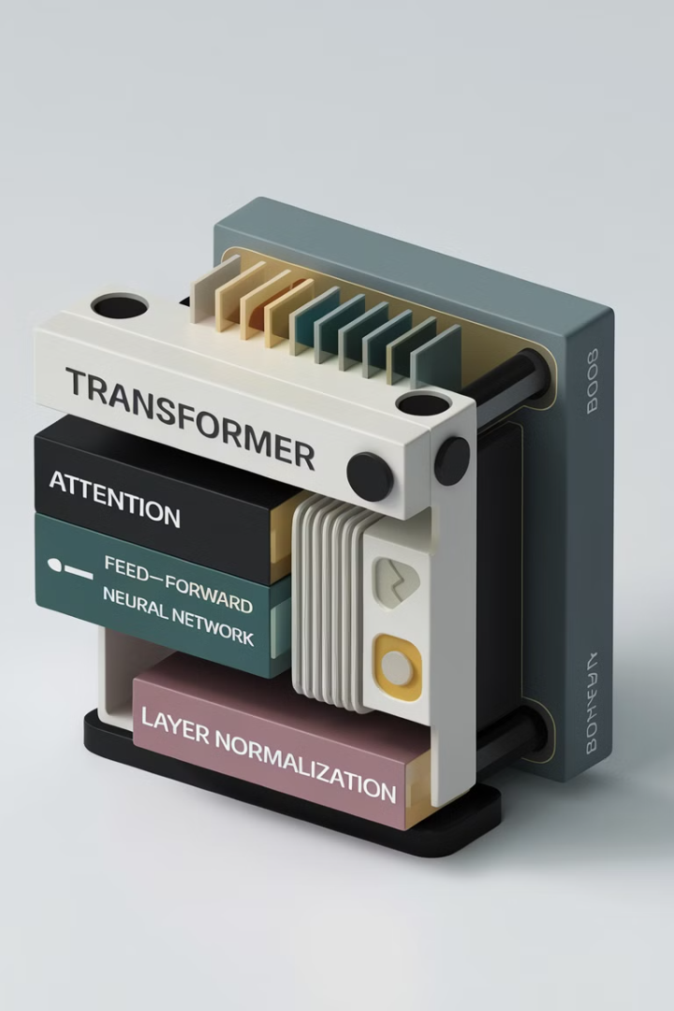
Transformer Layers and Blocks
Transformers are built from stacked layers, each consisting of multiple sub-layers, including self-attention, feedforward neural networks, and normalization layers.
These layers work together to learn complex relationships between elements in the input sequence, ultimately enabling the model to effectively process information and generate output.

Slide 17




Residual Connections and Layer Normalization
Residual Connections
Residual connections allow gradients to flow more easily through the network.
Layer Normalization
Layer normalization helps stabilize training and improve model performance.
Efficient Training
These techniques enable faster and more stable training of deeper Transformer models.

Slide 18
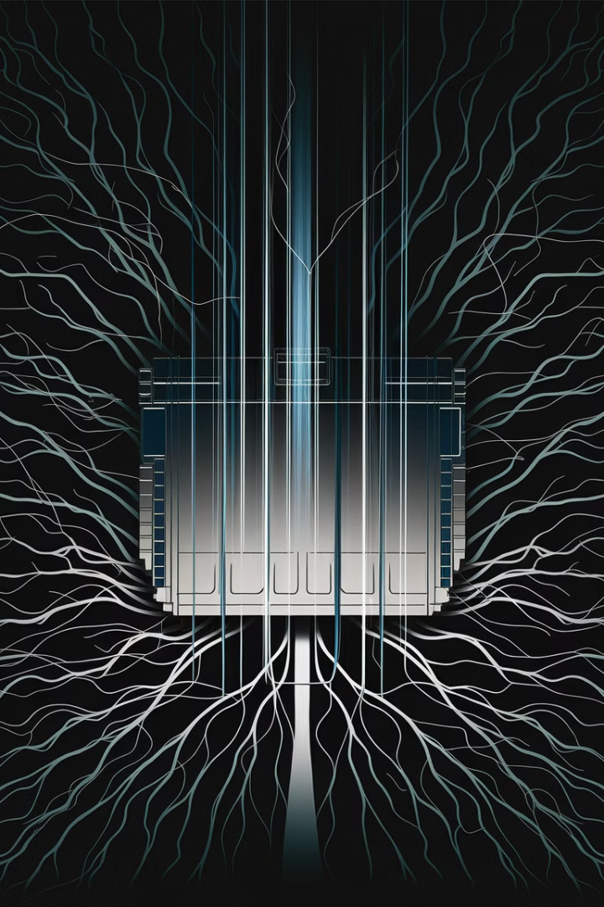
Transformer Architectures for Vision
1
Vision Transformer (ViT)
2
Swin Transformer
Swin Transformer excels in tasks like image segmentation and object detection.
A groundbreaking architecture, ViT introduced transformers to image recognition.
3
Deformable Transformers
Deformable Transformers leverage attention to enhance object detection performance.

Slide 19
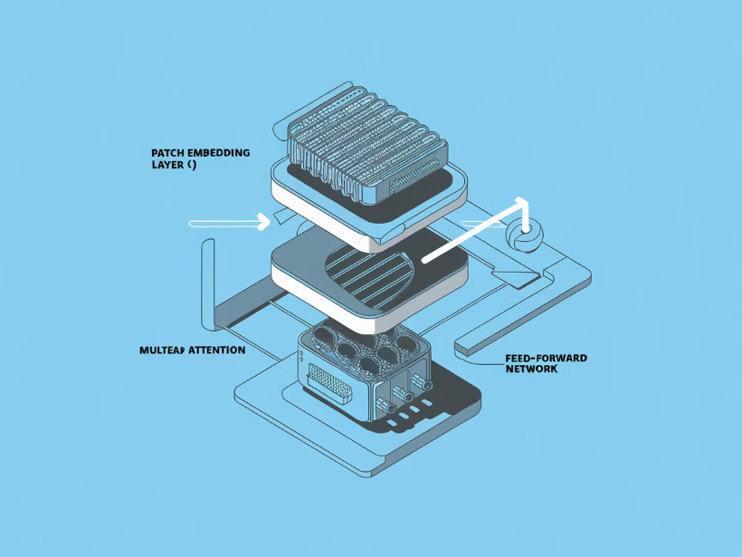
The Vision Transformer (ViT)
The Vision Transformer (ViT) is a groundbreaking model that adapts the Transformer architecture for image recognition tasks. It revolutionized computer vision by achieving state-of-the-art results on various image datasets.
ViT processes images as sequences of patches, similar to how transformers handle text sequences. It leverages self-attention mechanisms to capture long-range dependencies and relationships between these patches.

Slide 20

Swin Transformer
The Swin Transformer is a powerful architecture for computer vision tasks.
It utilizes a hierarchical window-based self-attention mechanism, capturing local and global dependencies in images.
This allows for efficient computation and superior performance compared to traditional convolutional neural networks (CNNs).

Slide 21
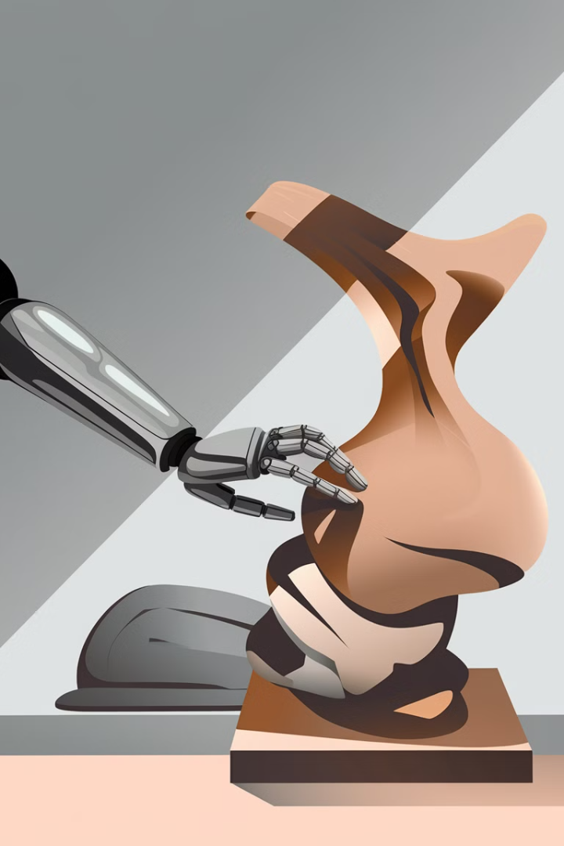
Deformable Transformers
Deformable transformers extend the capabilities of transformers by incorporating deformable attention.
This allows the model to focus on specific regions of interest within an image, dynamically adapting to object shapes and sizes.

Slide 22
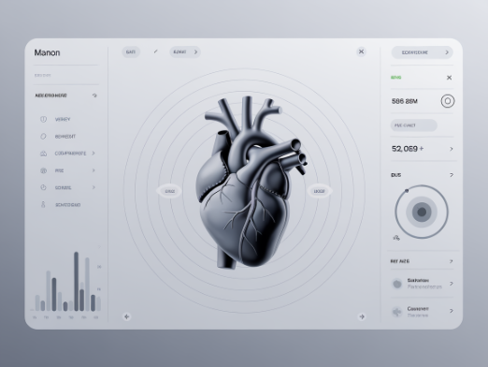
Transformers for Medical Imaging
Enhanced Image Analysis
Improved Accuracy and Efficiency
Transformers are increasingly used in medical imaging for tasks like image segmentation, object detection, and classification.
Transformers have shown promise in improving the accuracy and efficiency of medical image analysis compared to traditional methods.
These tasks involve identifying and analyzing specific structures and patterns within medical images, such as tumors, organs, and abnormalities.
They can capture complex relationships and dependencies within medical images, leading to more precise and reliable diagnoses.

Slide 23

Transformers for Remote Sensing
Earth Observation
Enhanced Accuracy
Data Interpretation
Remote sensing analyzes data captured from satellites or aircraft to monitor Earth's surface. This data provides insights into various aspects of the planet, such as land cover, environmental change, and urban development.
Transformers have shown promise in improving the accuracy of remote sensing tasks, such as image classification and object detection. Their ability to capture long-range dependencies in data is particularly beneficial for analyzing large-scale aerial imagery.
Transformers can help automate the process of extracting meaningful information from remote sensing data, such as identifying different land use patterns, detecting environmental hazards, and monitoring agricultural practices.

Slide 24

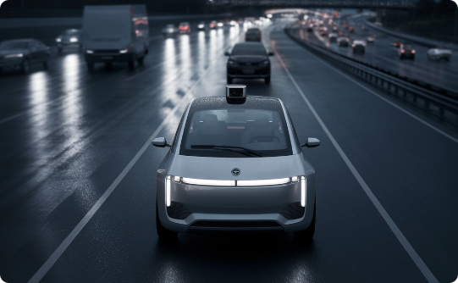

Transformers for Autonomous Driving
Enhanced Perception
Improved Decision-Making
Robust Navigation
Transformers enable autonomous vehicles to perceive their surroundings in real-time, identifying objects, lanes, and obstacles with high accuracy.
Transformers help autonomous vehicles make better decisions by analyzing complex traffic scenarios and predicting the behavior of other vehicles and pedestrians.
Transformers contribute to robust navigation by enabling autonomous vehicles to navigate complex and challenging environments, such as mountainous roads and urban areas.

Slide 25

Challenges and Limitations of Transformers
1
Computational Complexity
2
Memory Requirements
Self-attention requires processing all input tokens, increasing computation.
Transformers need to store all input tokens for attention, requiring substantial memory.
3
Interpretability
Understanding the reasoning behind decisions made by Transformers can be challenging.

Slide 26
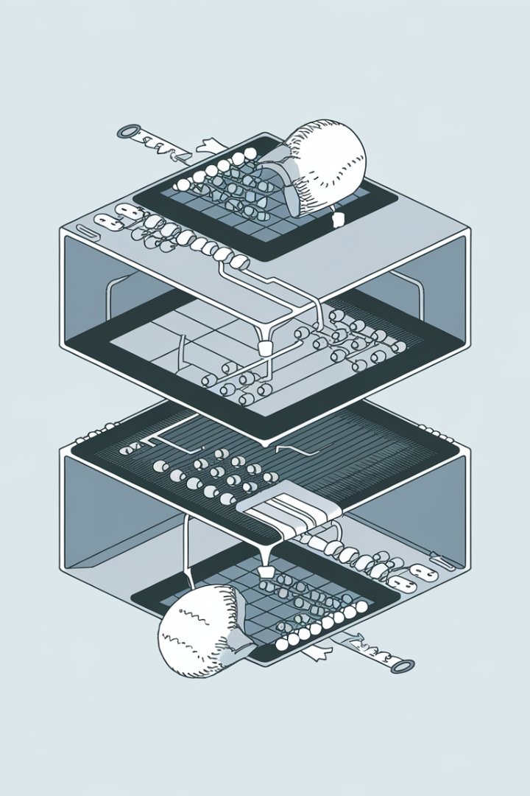
Efficiency and Scalability of Transformers
Computational Cost
Memory Constraints
Transformers, especially with a large number of parameters, can be computationally expensive, particularly for complex vision tasks.
Handling large input images and processing them through multiple attention layers can strain memory resources.
Optimization Techniques
Hardware Acceleration
Efficient training strategies like mixed precision training and gradient accumulation are crucial for practical application.
Specialized hardware such as GPUs and TPUs are vital for achieving optimal performance and scalability.

Slide 27


The Future of Transformers in Computer Vision
Further Research
Integration with Other Techniques
Expanding Applications
Ongoing research focuses on improving efficiency and addressing limitations, exploring new architectural designs and training techniques.
Transformers are anticipated to be used in diverse applications, including medical imaging, remote sensing, and robotics.
Transformers are expected to be combined with other computer vision techniques, such as CNNs, for enhanced performance.

Slide 28
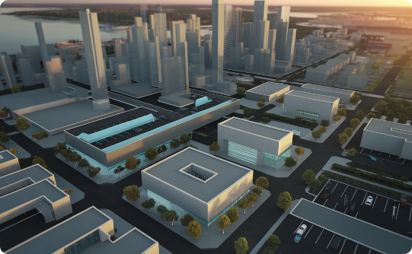

Real-World Applications and Case Studies
Autonomous Driving
Medical Imaging
Remote Sensing
Transformers enhance object detection and lane recognition, leading to safer and more efficient autonomous vehicles.
Transformers aid in medical image analysis, including disease detection, segmentation, and diagnosis.
Transformers improve land cover classification, environmental monitoring, and disaster response with aerial imagery.

Slide 29
Ethical Considerations and Bias in Transformers
Fairness and Bias
Data Privacy and Security
Transformers can inherit and amplify biases present in training data. This can lead to unfair or discriminatory outcomes in applications like facial recognition or medical diagnosis.
Transformer models may be trained on sensitive data, raising concerns about privacy violations and the potential misuse of information.

Slide 30


Conclusion and Key Takeaways
1
Transformers Revolution
2
Self-Attention Power
Transformers have ushered in a new era in computer vision, offering exceptional performance across various tasks.
The self-attention mechanism empowers transformers to capture long-range dependencies and contextual information.
3
Adaptability and Versatility
4
Continued Advancements
Transformers can be effectively applied to diverse vision tasks, from image classification to object detection.
Research continues to explore new transformer architectures and applications, paving the way for future innovations.

